Slide 1

Indian Government Dataset
By:
Name: C. Harshitha Hridya

Slide 2
Introduction
The dataset analyzed in this project focuses on crime statistics for January 2024. It includes numerical data representing crime occurrences across different timeframes and crime categories. The goal is to identify trends, patterns, and anomalies that can aid in crime prevention and policy-making.

Slide 3
Dataset Overview
The dataset contains multiple numerical columns tracking crime incidents across different periods.
Initial data checks revealed missing values, which were handled appropriately.
Columns were cleaned by stripping whitespace and ensuring proper formatting.

Slide 4
Crime Distribution Analysis
Histograms were used to visualize how crime numbers vary across different time frames.
These graphs help in understanding the spread of crime data and detecting unusual spikes.
For example, a significant increase in crime reports during a specific month may indicate external influencing factors.

Slide 5
DATA CLEANING & PREPARATION
Handling Missing Values: Missing values were addressed using appropriate imputation techniques.
Checking Data Types: Ensured correct data types for numerical and categorical columns.
Grouping by Major Crime Categories: Data was aggregated by 'Major Head' where applicable.
Outlier Detection: Box plots were used to identify extreme values.

Slide 6
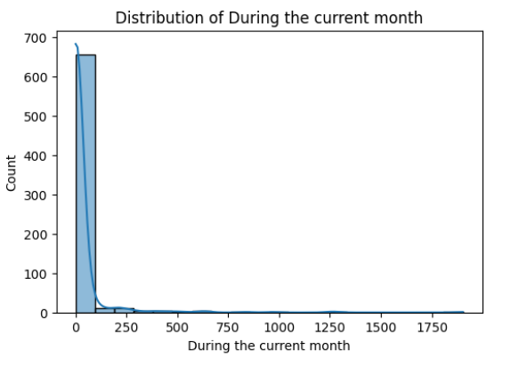
KEY ANALYSIS & VISUALIZATIONS
Crime Distribution Over Different Periods
Histograms were used to analyze crime trends across:
Current month
Previous month
Corresponding month in the previous year
Year-to-date totals

Slide 7
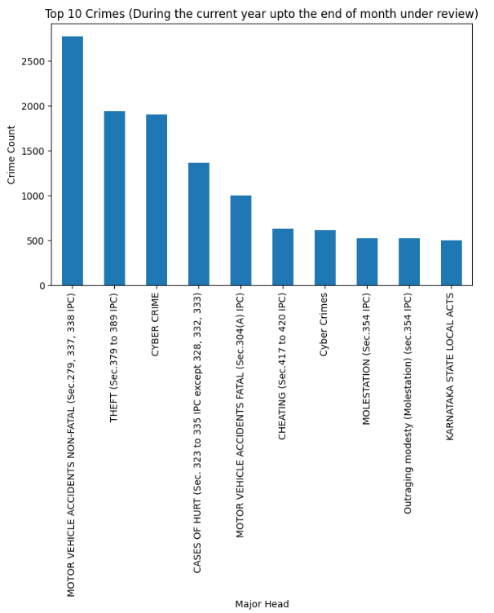
State-wise Crime Trends
Bar plots highlighted states with the highest crime rates.
Some states exhibited significantly higher crime occurrences than others.

Slide 8
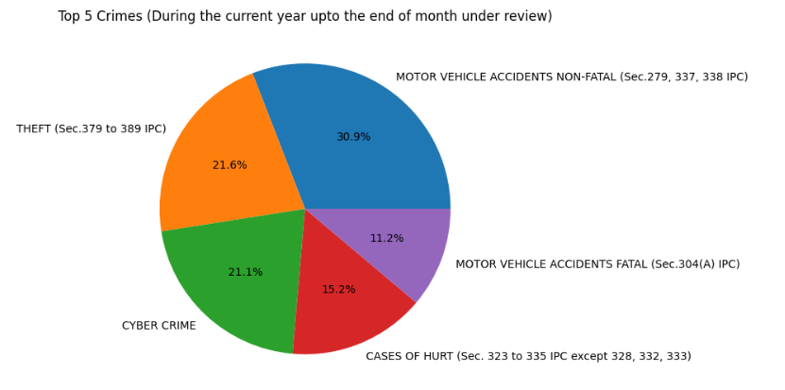
Comparison of Major Crime Categories
Grouped crime counts by major categories to identify dominant crime types.
Pie charts were used to illustrate the proportion of different crime types.

Slide 9
CONCLUSION
The analysis of crime data for January 2024 provided valuable insights into crime trends across different timeframes and regions. Key findings highlight variations in crime rates by state, seasonal influences on crime types, and overall patterns that can help in policy formulation. By leveraging visualizations such as histograms, bar charts, and pie charts, we identified areas requiring attention from law enforcement agencies. Future improvements in data collection and proactive crime prevention strategies can enhance public safety and reduce crime rates effectively.

Slide 10
THANK YOU

